Slide 1
Long-Term Trends in Great Lakes Ice Coverage
Brandon, Anton, and Lily

Slide 2
Research Question
Has Great Lakes ice coverage significantly changed over time?
Which aggregation metric best captures trend?
Mean annual ice coverage
Maximum annual ice coverage
Area Under Curve (AUC)
Does year-to-year dependence affect conclusions?

Slide 3
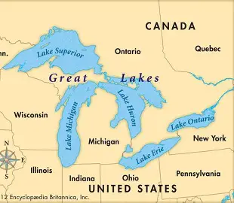
Research Context
Ice decline may serve as a regional signal of climate change
Impacts ecosystems and regional economies
Sensitive climate indicator

Slide 4
Data Overview
Key variables: Date/Season, Year, Percent Ice Coverage
Calculated variables:
Annual Mean Ice Coverage
Annual Maximum Ice Coverage
Annual Area Under the Curve (AUC)

Slide 5
Data Cleaning Challenges
Handling missing values (2 types)
Some years (especially early ones) first measurement is high
If first observation greater than 5 we calculated average change in ice coverage over first 10 days and imputed previous values by subtracting that change until we get to zero or fill in 10 days
Assume other NAs are 0% ice coverage

Slide 6
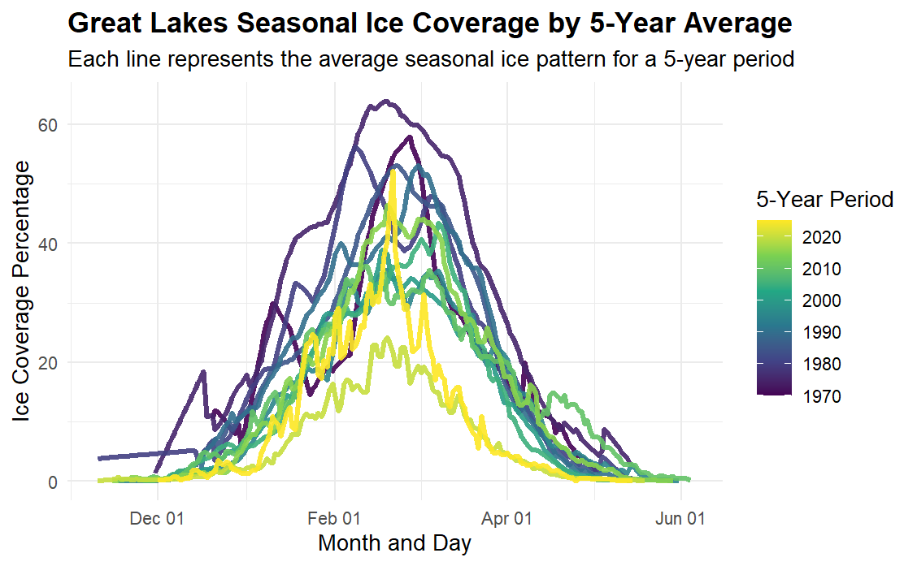
EDA
Ice Coverage in both Magnitude and Duration seems to be generally decreasing over time

Slide 7
Yearly Ice Coverage Aggregation Metrics
Area Under Curve
Capture both Magnitude and Duration of Ice Coverage
Often used in similar situations in pharmacokinetics
Mean Ice Coverage
Simple and easy to understand
May miss duration effect (ie short severely cold winter might have same mean ice coverage as long moderately cold winter)
Max Ice Coverage
Simple and easiest to understand

Slide 8
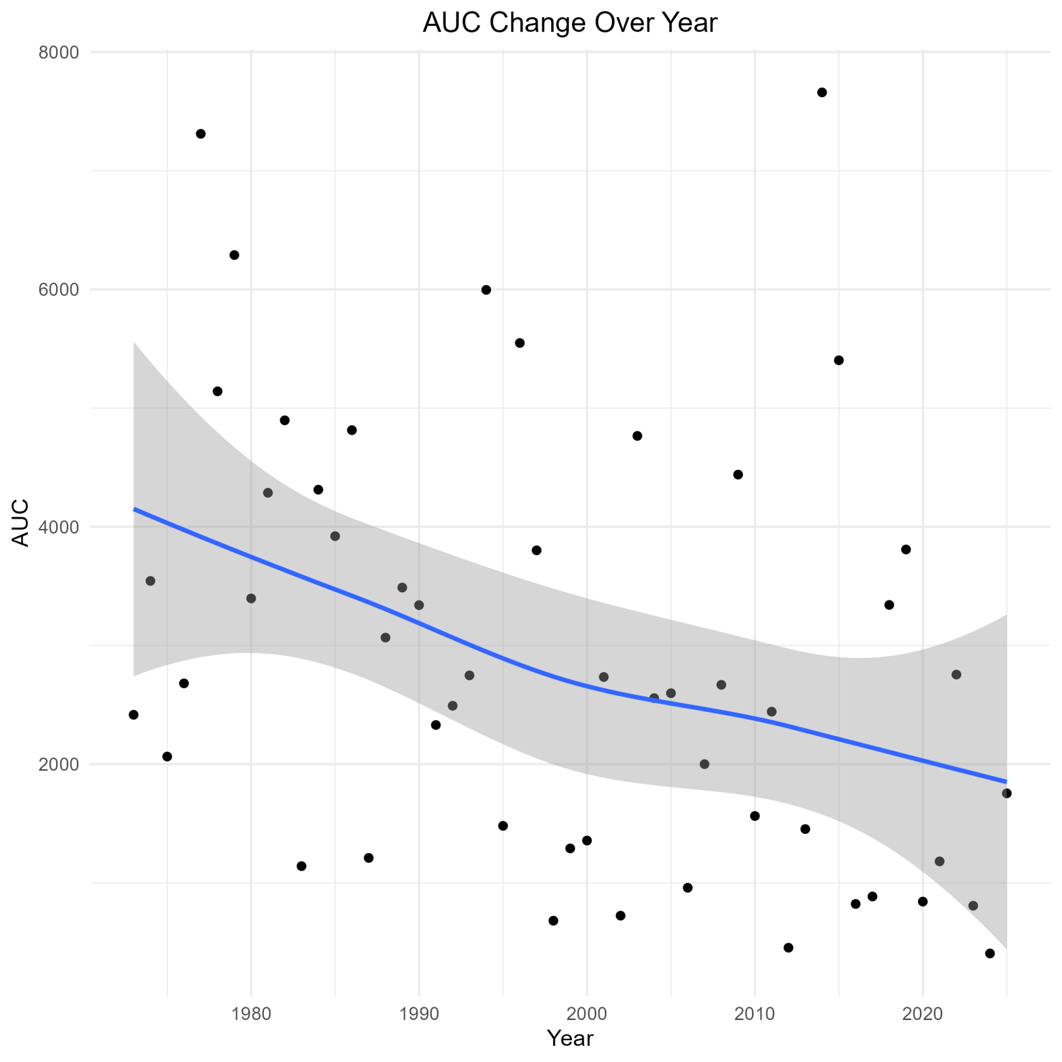
Summary of AUC
Weak linear decreasing trend in AUC over time

Slide 9
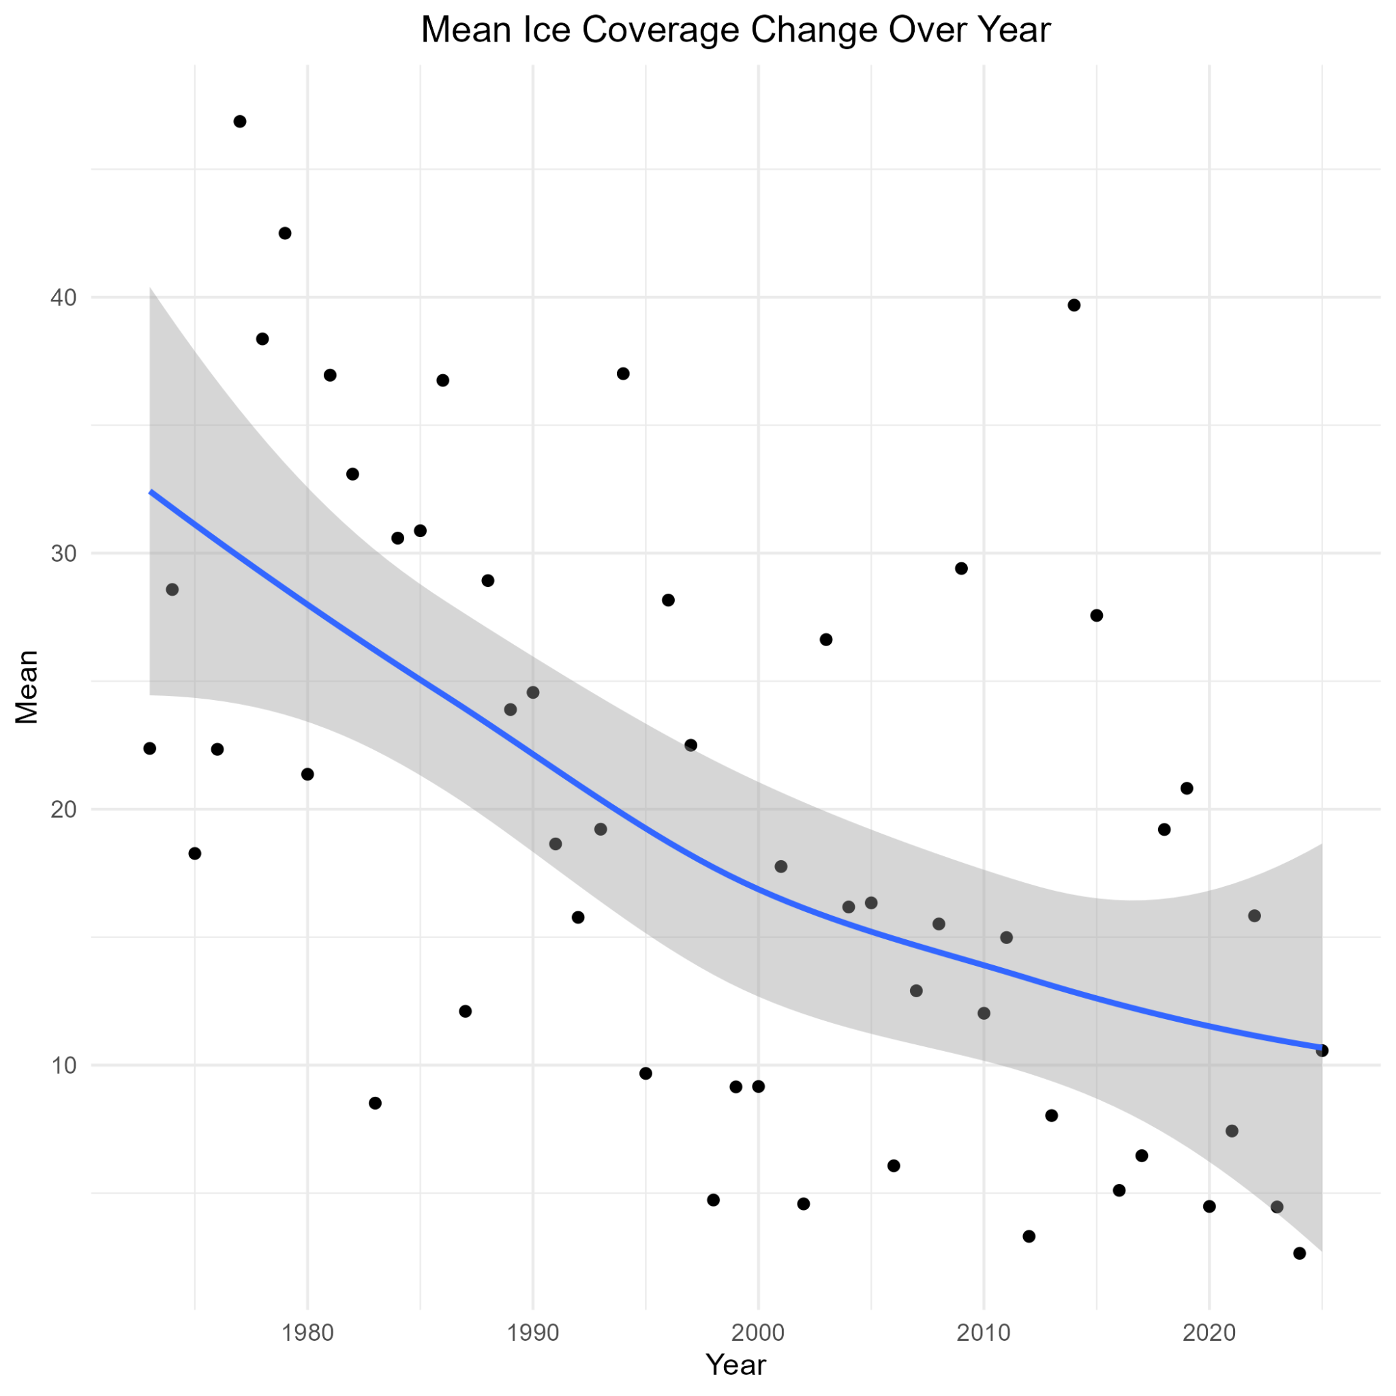
Summary of Mean Ice Coverage
Weak linear decreasing trend in Mean Ice Coverage over time

Slide 10
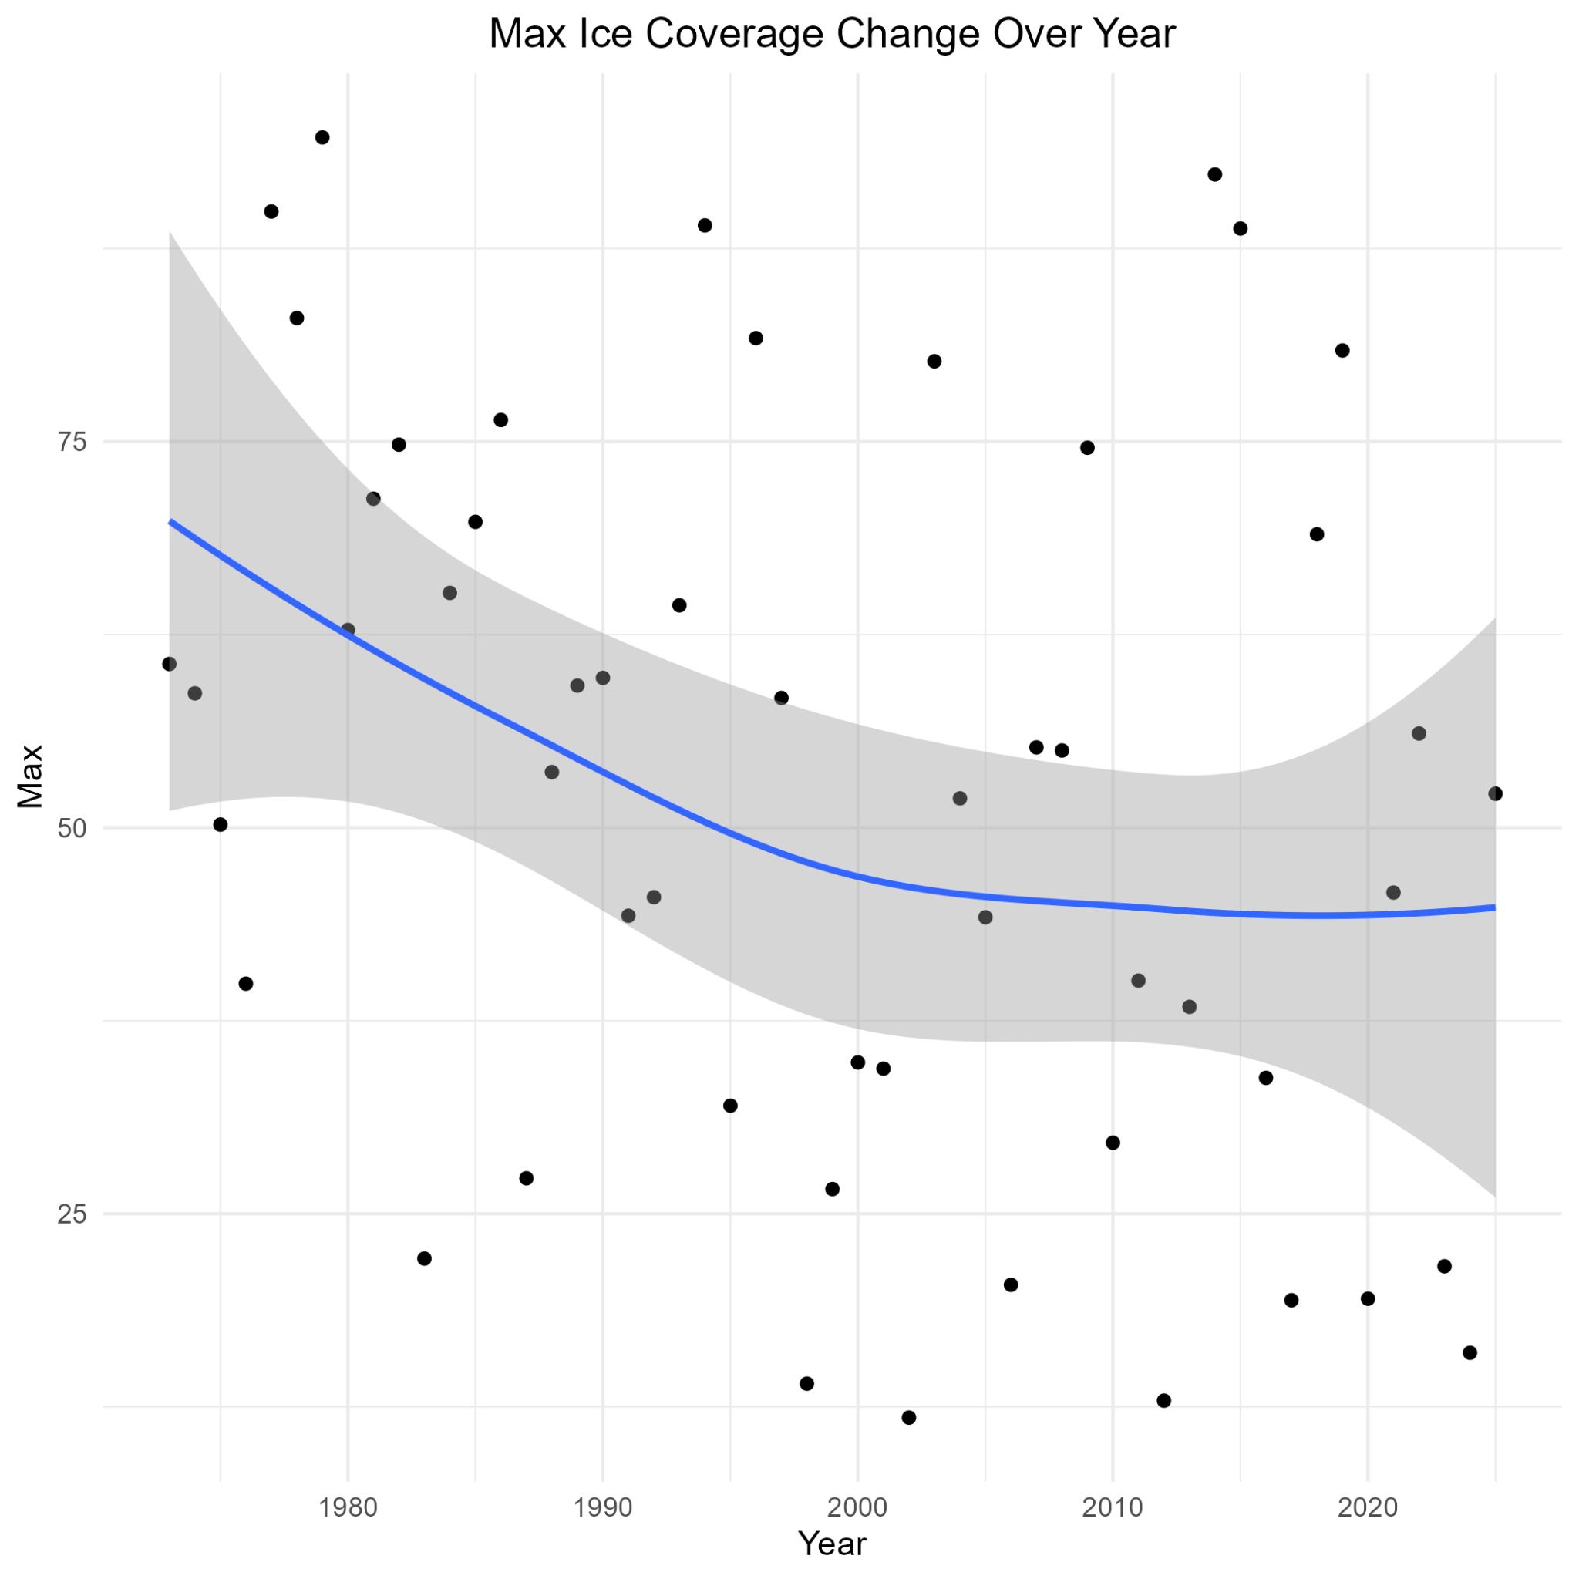
Summary of Max Ice Coverage
Very weak decreasing trend in Max Ice Coverage over time
Max Ice Coverage not the best aggregation method anyway since it only uses measurement from 1 (possibly extreme) day

Slide 11
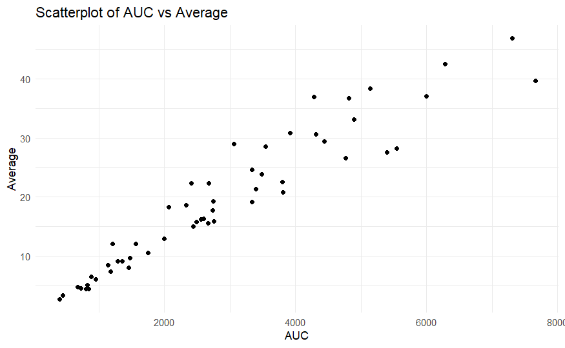
Correlation of variables
AUC was initially preferred since it captures duration of ice as well as magnitude.
Since Mean and AUC are strongly correlated (0.9505), Mean might be just as good as AUC.

Slide 12
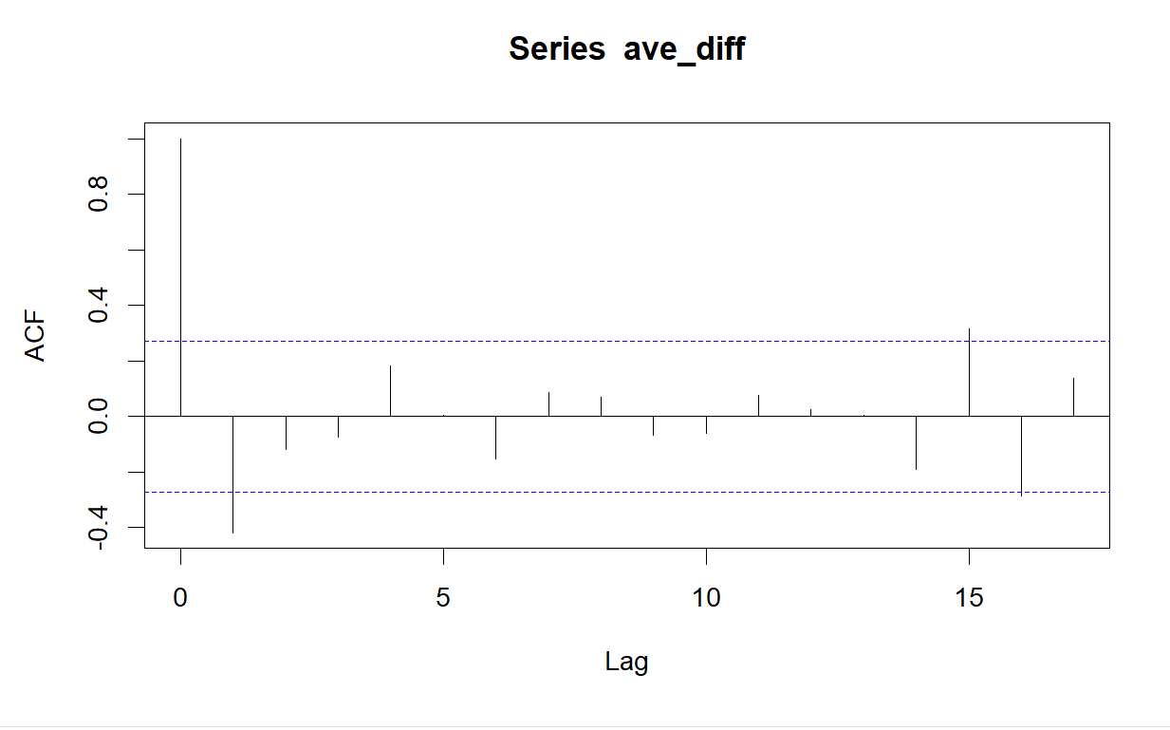
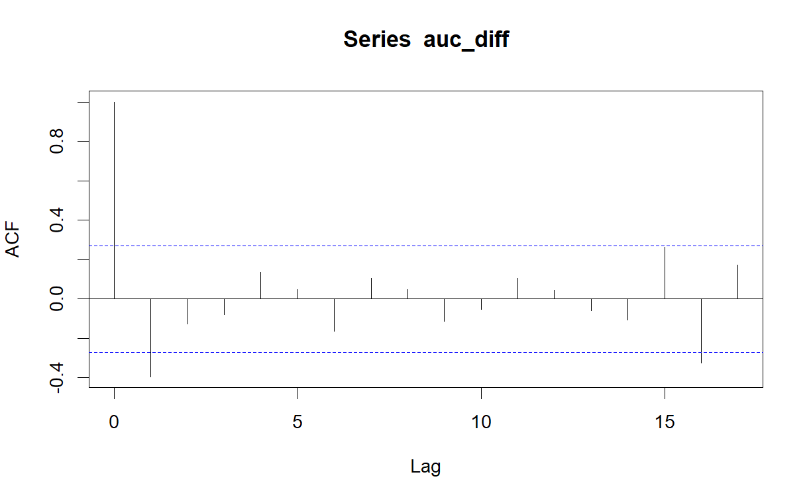
AutoCorrelation Check (Previous Year’s effect)
Observations are not independent (violates Linear Regression Assumptions)
Lags were studied, Ice Coverage of a year correlated with the Ice Coverage of previous year (for both AUC and Mean)

Slide 13
Linear Regression Analysis
Two Proposed Models
Mean ~ Year + Avg_prev
AUC ~ Year + AUC_pre
Observation from previous year (1 lag) included as a predictor to account for its effect
Can’t compare models with typical metrics (R² etc) since they have different response variables

Slide 14
Standardized Regression
To compare models with different responses we scale both the X’s and Y’s to a Mean 0, Var 1, and then refit models
“New” coefficients called Beta Weights
How many standard deviations Y changes with one standard deviation change in X
Can compare to see which response X is a stronger predictor of

Slide 15
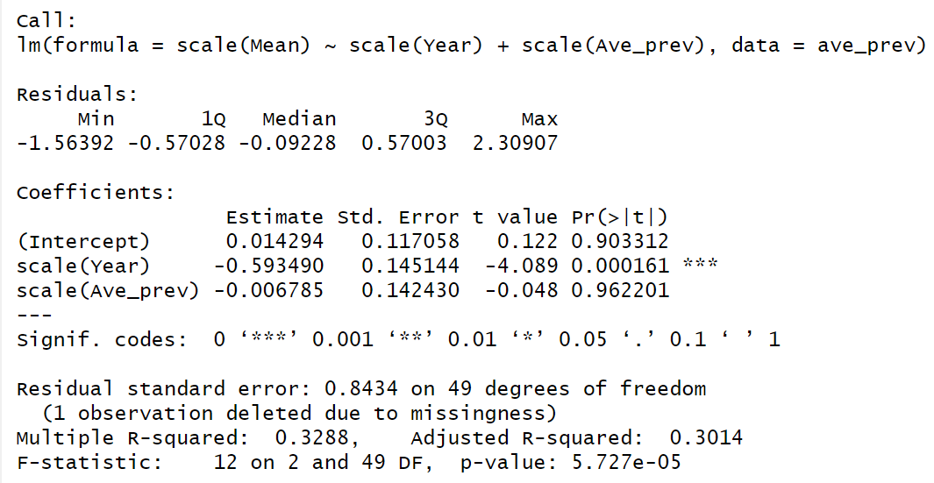
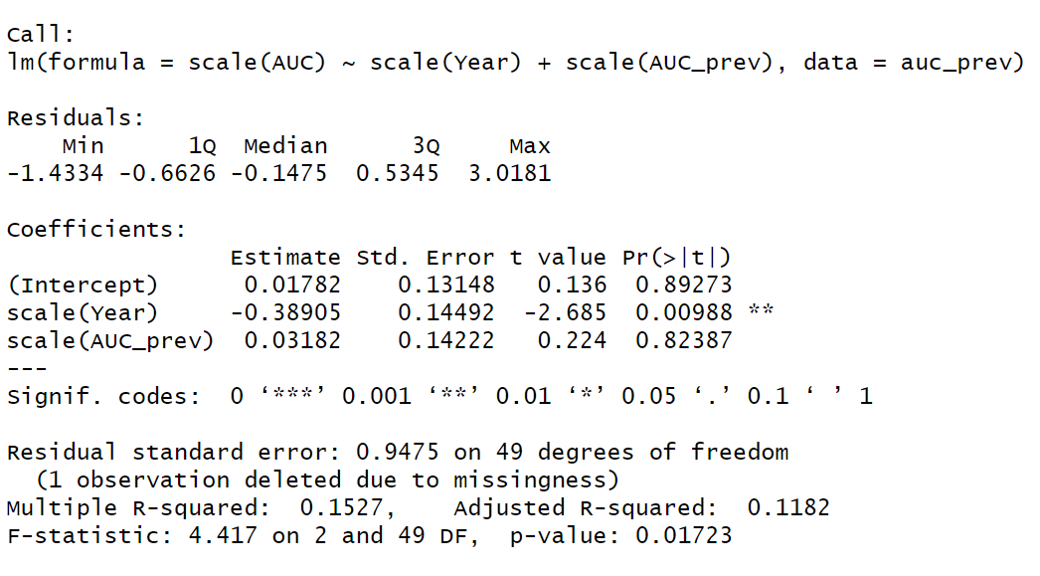
Standardized Regression Results
Model with mean has larger (in magnitude) than model with AUC
Year has a more pronounced effect on Mean so we will use the AUC model to be more conservative

Slide 16
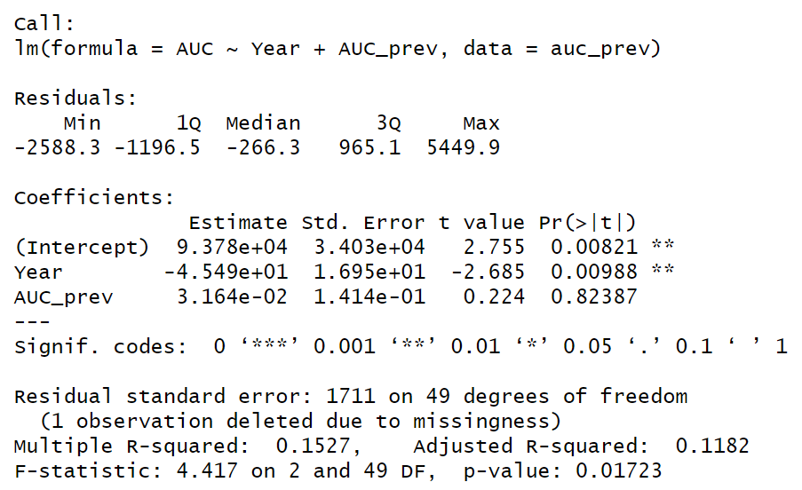
Results
Year significant predictor of Ice Coverage AUC (p=0.00988)
On average Ice Coverage AUC decreases by 45.49 per year holding previous Ice Coverage AUC Constant

Slide 17
Returning to Research Questions
Great Lakes Ice Coverage has significant decreasing trend over time (AUC decreases by 45.49 per year on average)
Aggregating data with Mean and AUC both captured this trend
Used AUC which had a weaker trend to be more conservative
Ice Coverage of Previous Year has an effect on the Ice Coverage of a Year
Handled this by adding 1 lag to regression model

Slide 18
Limitations
Relatively small period of time (1973-2025)
Unusual weather events likely impacted Ice Coverage some years
2014 Polar Vortex, 1977 & 1978 Blizzards

